Slide 1
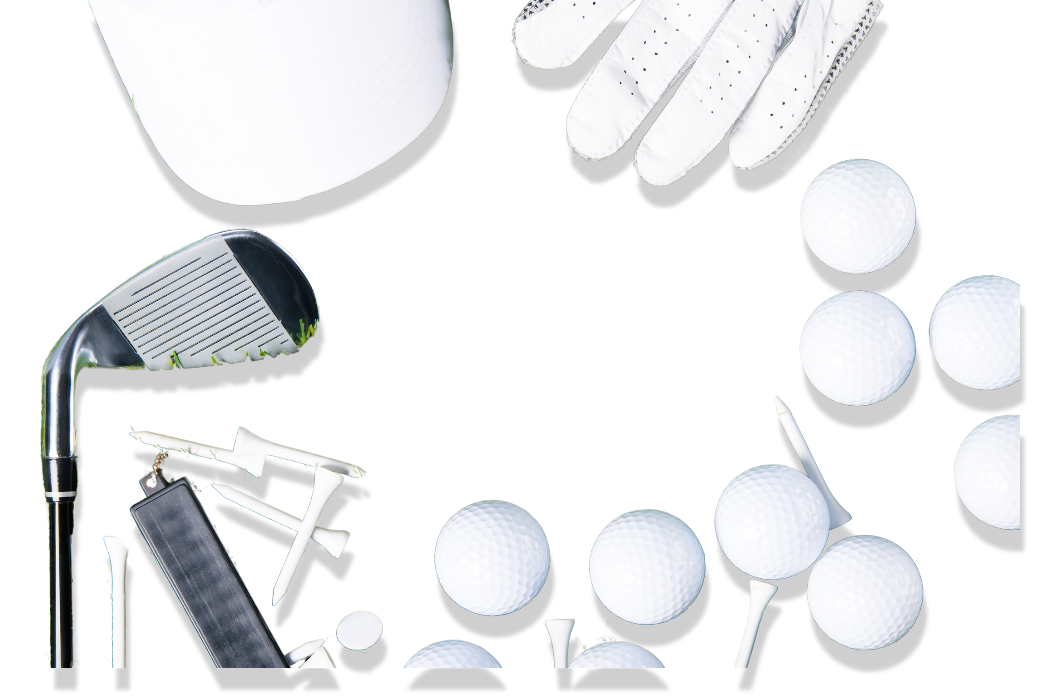


Innovation Day
FORES GHT
INNOVATORS

Slide 2
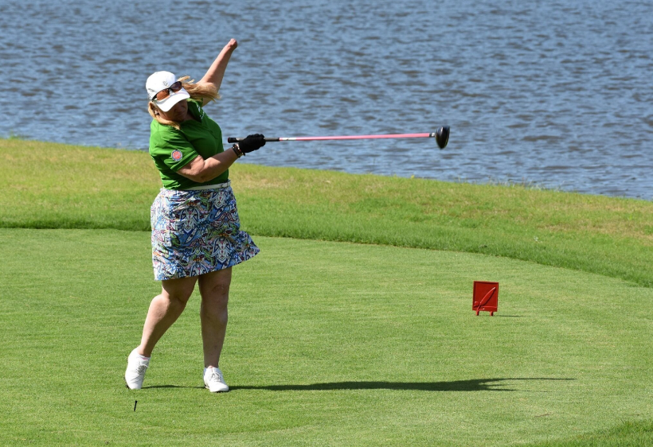
CONTENT
01
Project Overview
02
Problem and Purpose
03
Research and Insights
04
Solution and Product Design
05
Prototype Development
06
Testing and Refinement
07
Conclusion

Slide 3

PROJECT OVERVIEW
Adaptive golf is a modified version of golf designed to make the sport accessible and enjoyable for individuals with physical, cognitive, or sensory disabilities by using specialized equipment, techniques, and inclusive environments.
Notes:
Adaptive golf is a modified version of golf designed to make the sport accessible and enjoyable for individuals with physical, cognitive, or sensory disabilities by using specialized equipment, techniques, and inclusive environments.

Slide 4

PROBLEM AND PURPOSE
Problem Statement:
Adaptive golfers face complications, with arthritis being a leading development from single-arm swinging
Project Objective:
Prevent injuries, enhance grip, and boost confidence while promoting inclusivity in adaptive sports. Designed to assist in preventing wrist arthritis for one-armed golfers.
Notes:
Project Objectives: The product is designed to prevent injuries, enhance grip and support, and boost confidence for adaptive athletes, specifically promoting inclusivity in adaptive sports. Its innovative design aims to assist in the prevention of arthritis formation in the wrist, providing ergonomic and functional support tailored to the needs of one-armed golfers and other individuals with upper body disabilities.

Slide 5
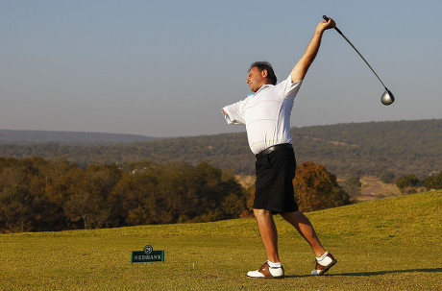

RESEARCH
Studies indicate that unilateral overuse is a significant risk factor for osteoarthritis, as cartilage wear accelerates under continuous stress (Lohmander et al., 2007). Additionally, individuals engaged in repetitive sports-related motions are at an increased risk of joint degeneration over time (Felson, 2013).
Notes:
Studies indicate that unilateral overuse is a significant risk factor for osteoarthritis, as cartilage wear accelerates under continuous stress (Lohmander et al., 2007). This research demonstrated that the long-term risk of osteoarthritis is increased due to the abnormal mechanical load on bodily joints after an injury.
Additionally, individuals engaged in repetitive sports-related motions are at an increased risk of joint degeneration over time (Felson, 2013). This study concluded that osteoarthritis is influenced by mechanical factors, where repetitive joint stress leads to cartilage breakdown, particularly in weight-bearing joints.

Slide 6
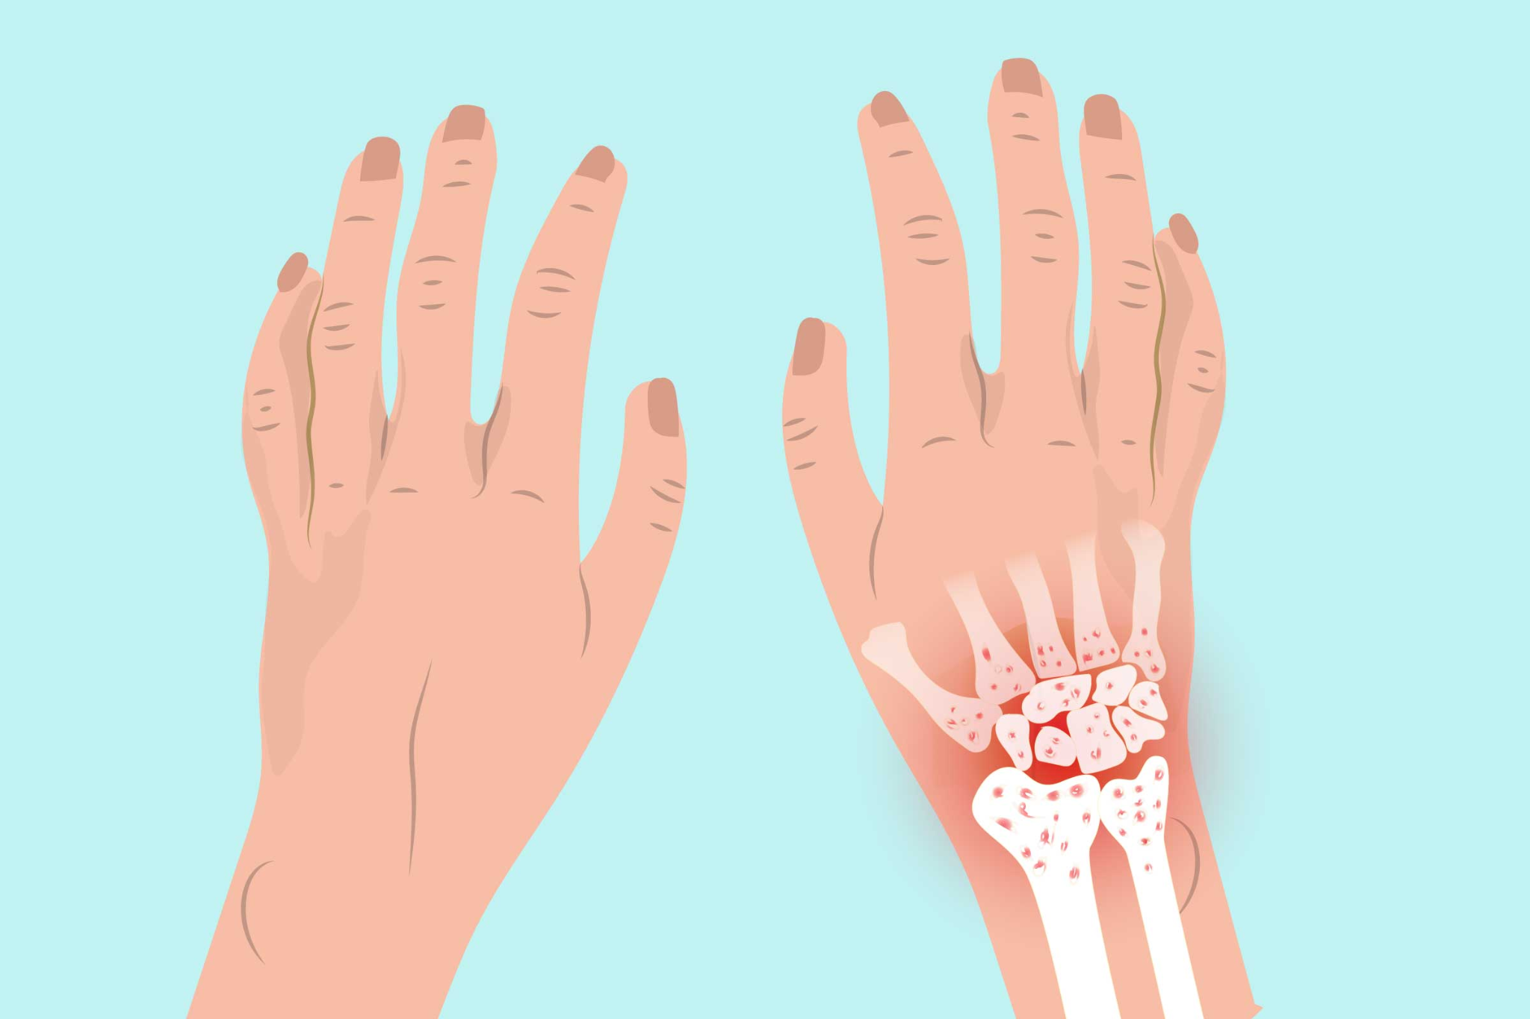
INSIGHTS
Key Research Findings
Field Insights
Continuous overuse of a single limb, especially in high-impact and repetitive activities like golfing, can increase the risk of developing osteoarthritis.
For amputees who rely heavily on one arm, the biomechanical strain is disproportionately placed on the unaffected limb, compounding the risk.
Notes:
end - keeping these findings in mind, we came up with an accessible design for our product…

Slide 7
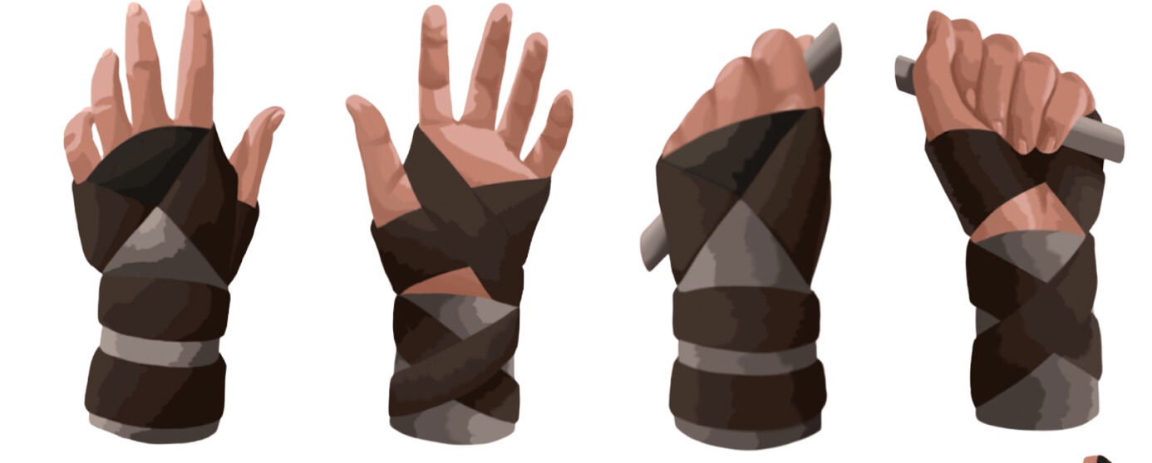
SOLUTION AND PRODUCT DESIGN
Introducing the Adaptive Glove: ArthroGrip The revolutionary golfing equipment made to provide support while preventing the development of Arthritis

Slide 8

PROTOTYPE DEVELOPMENT
Unique Features and Differentiation: With the elastics component of the glove, users are able to adjust the tightness and strength as they see fit.
Broader Applicability:
Due to the design of the glove, the ArthroGrip can be used by various demographics and for non-golfing purposes.
Ethical and Practical Considerations:
Ethically sourced materials were used, affordability and accessibility was prioritized during production, privacy and confidentiality were maintained in user interviews.

Slide 9
PROTOTYPE REFINEMENT
Implemented Improvements:
The criss-cross pattern creates variation in function, whether its enhanced security by wrapping around the club shaft, or enhanced grip by using the adhesive elastic for additional club grip .
Elastic bands featuring velcro straps highlight the functionality, and the rods in the wrist sleeve facilitate wrist stability through the swinging motion
Implemented Improvements:
Tension rods increase stability in the wrist, by providing security through the swing path
Implemented Improvements:
The velcro straps aid in adjustability, for both comfort and security for our user

Slide 10
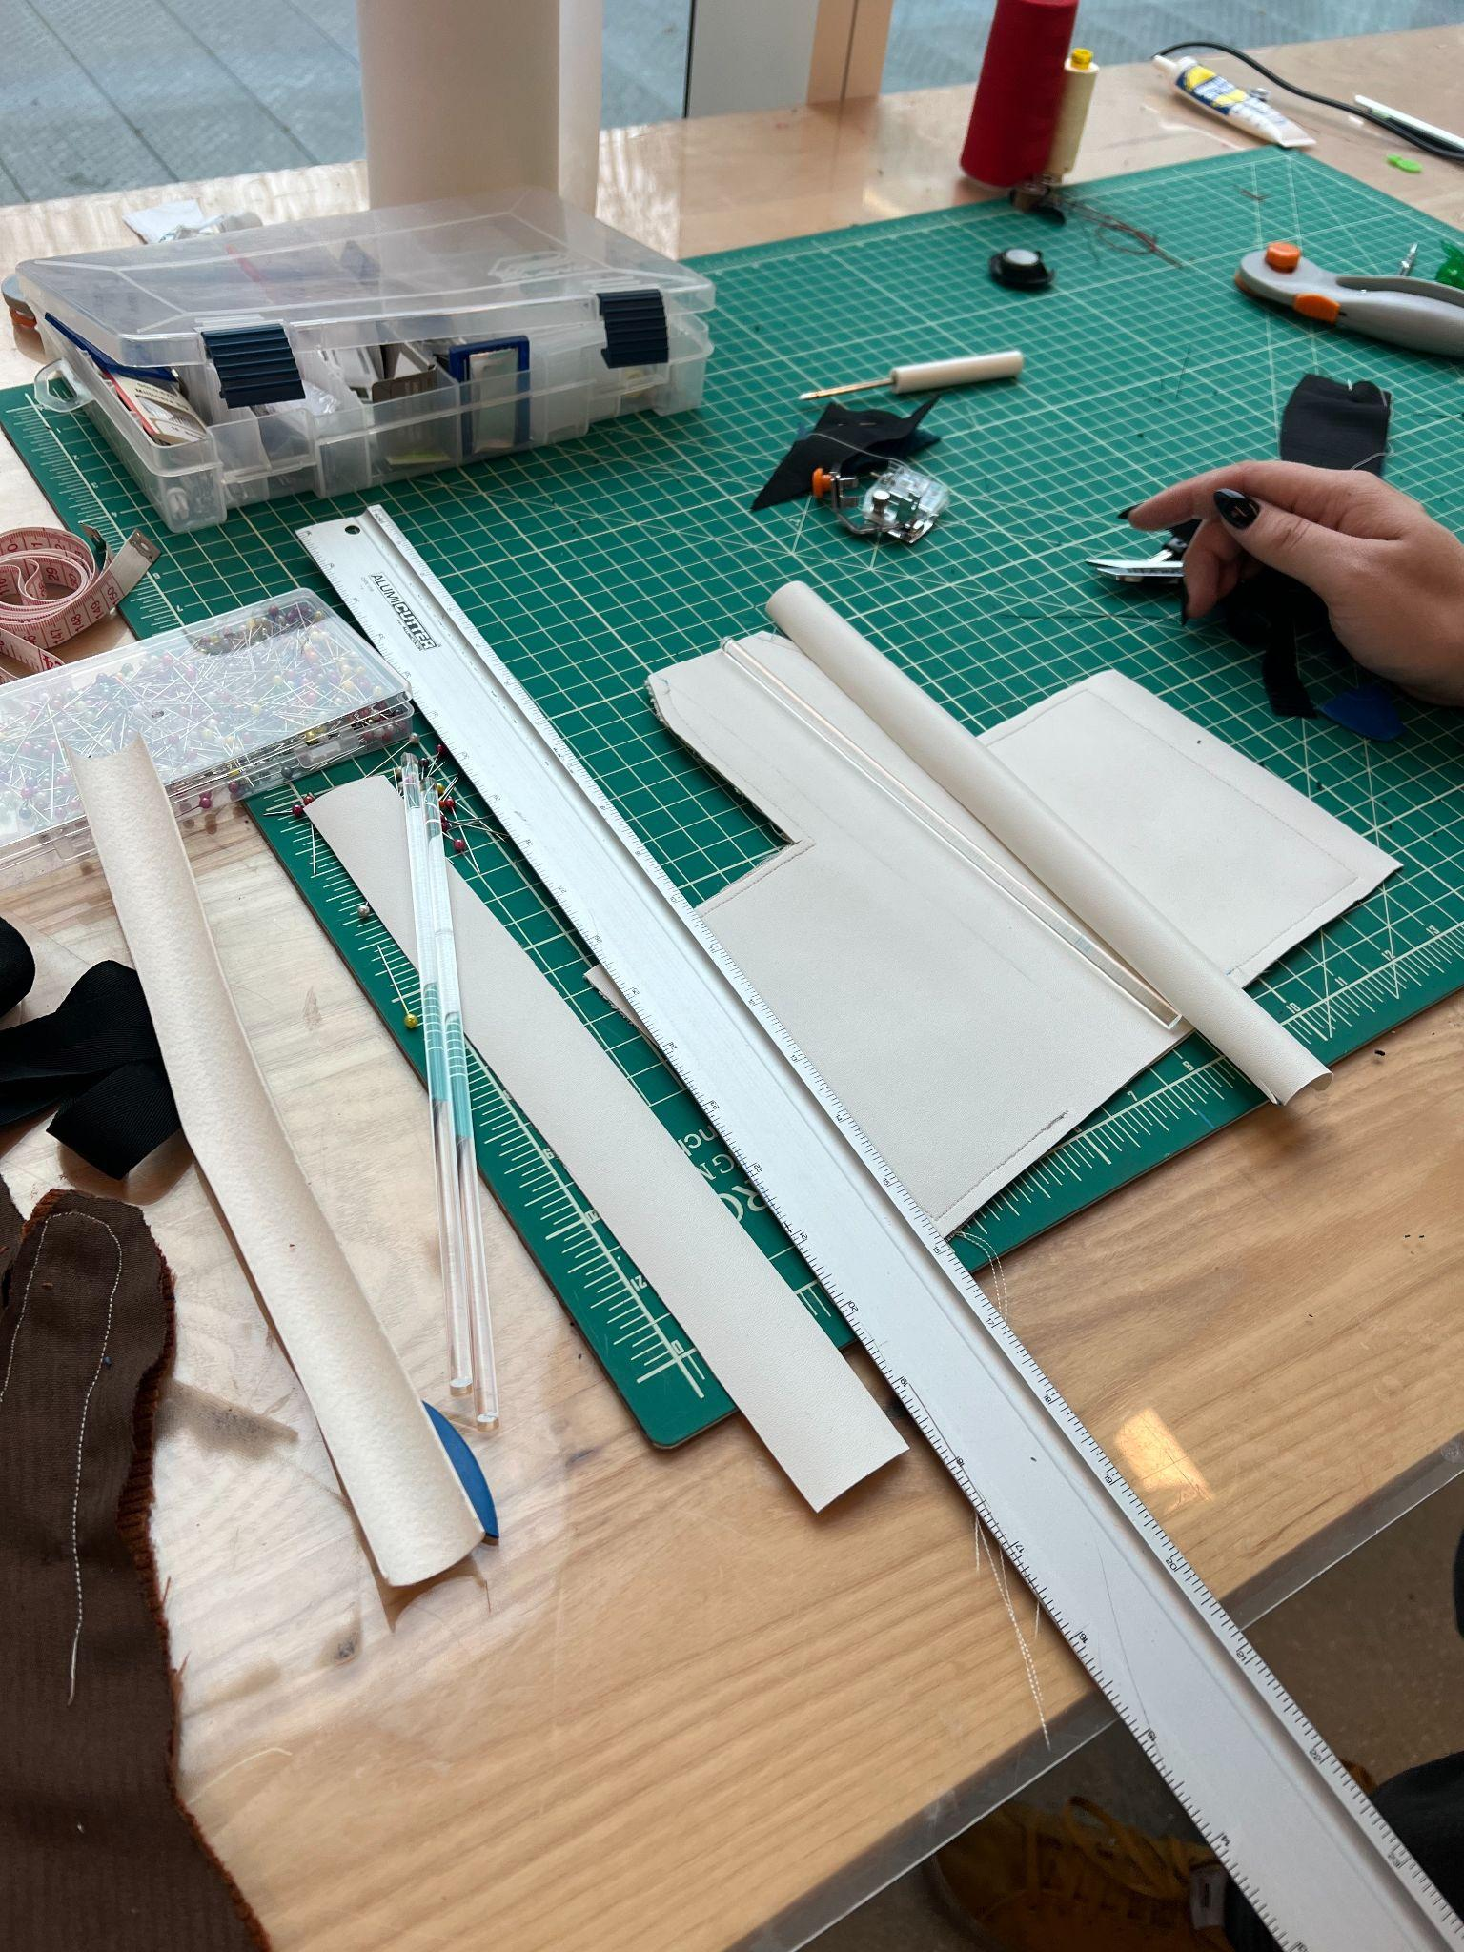
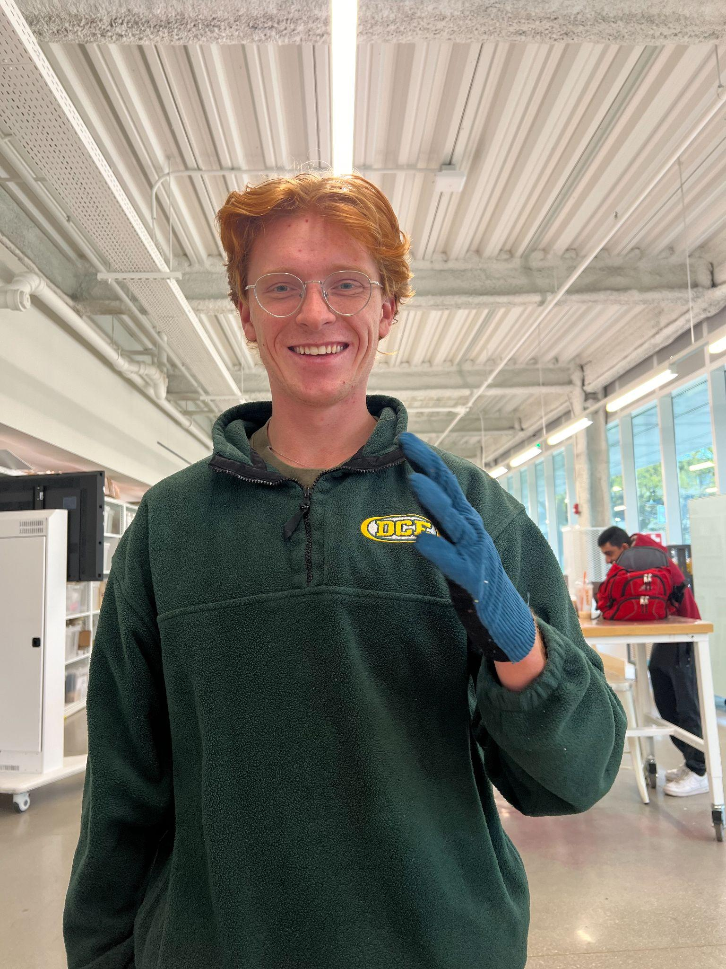
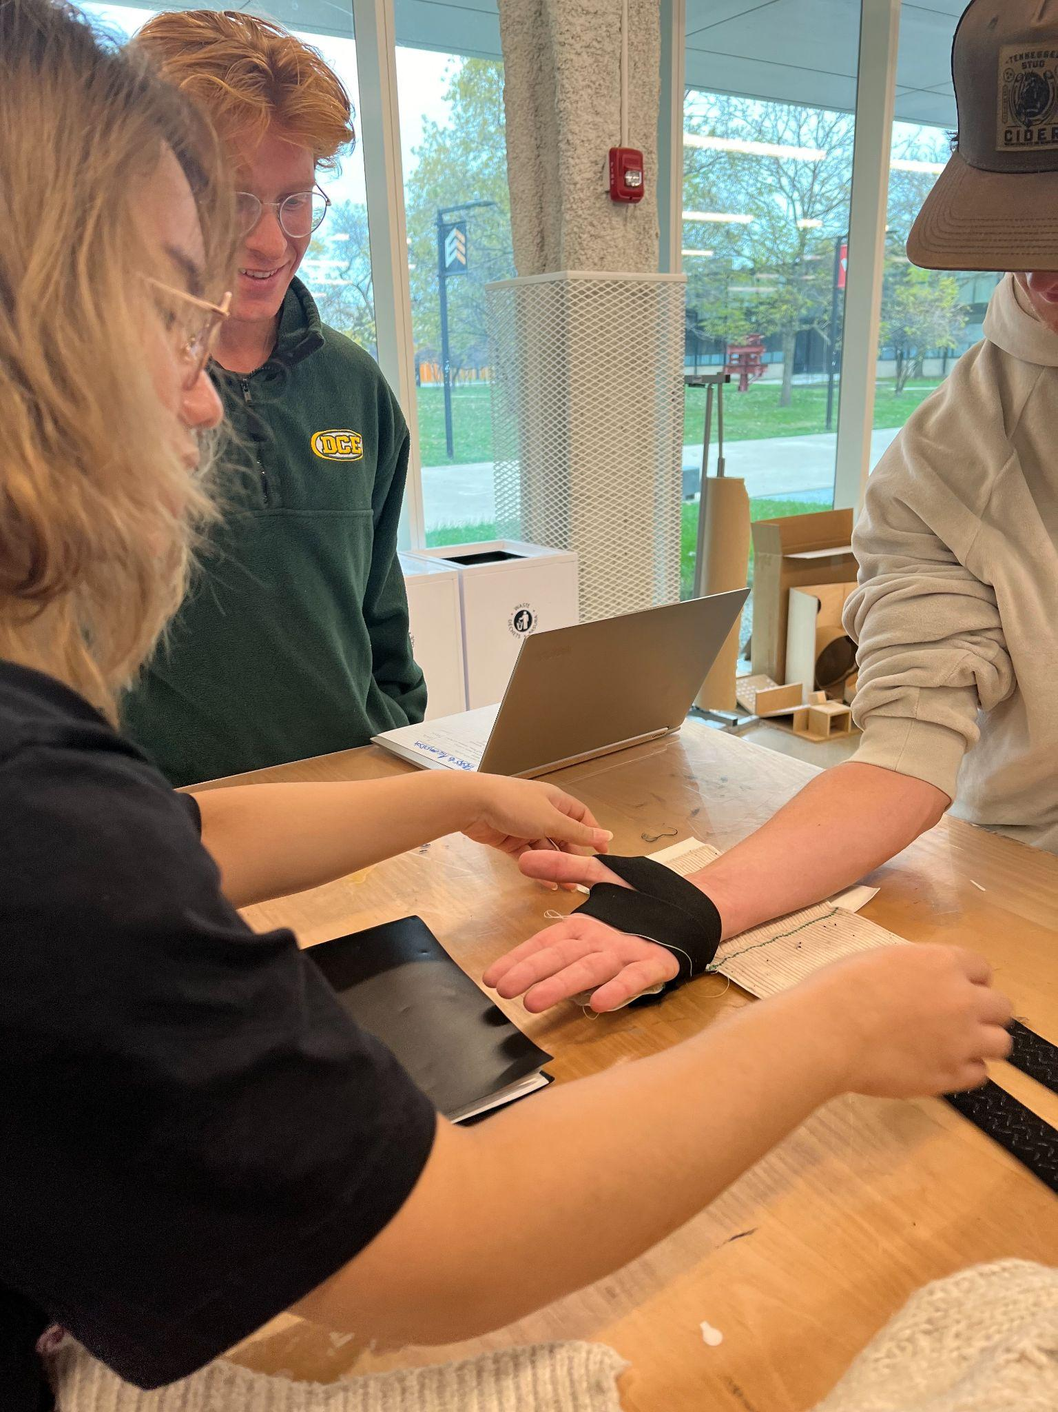
WORK IN PROGRESS

Slide 11
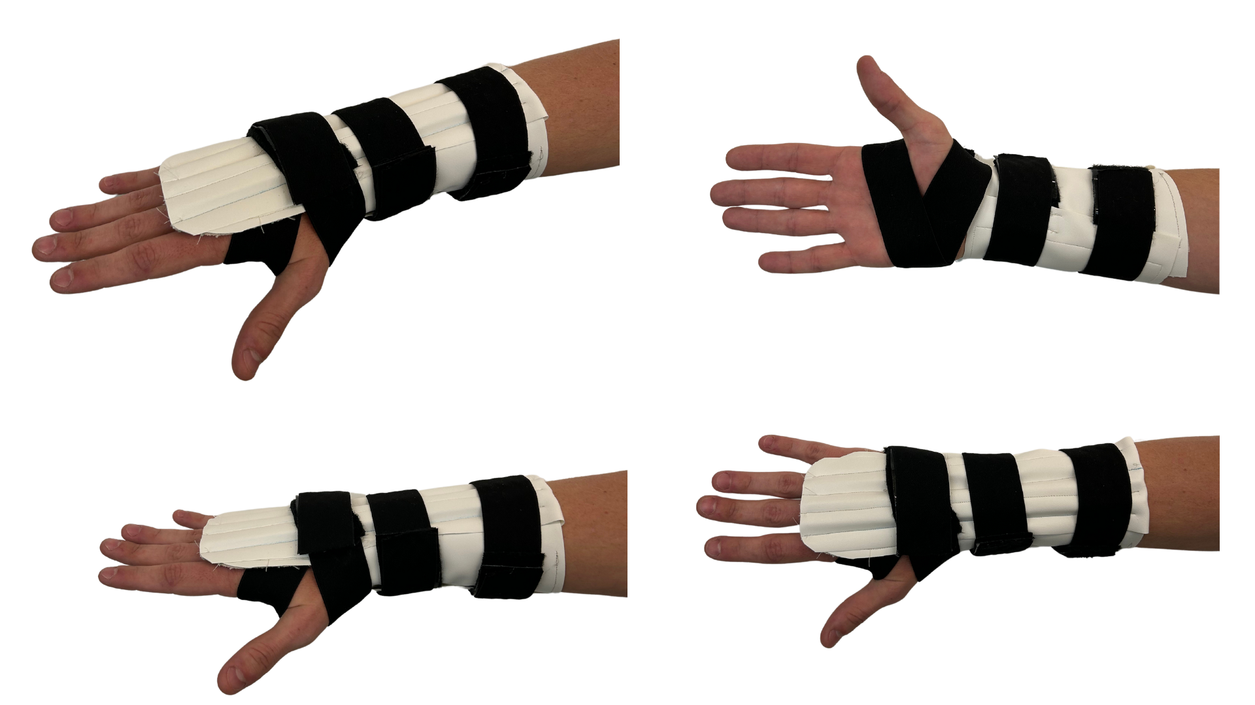
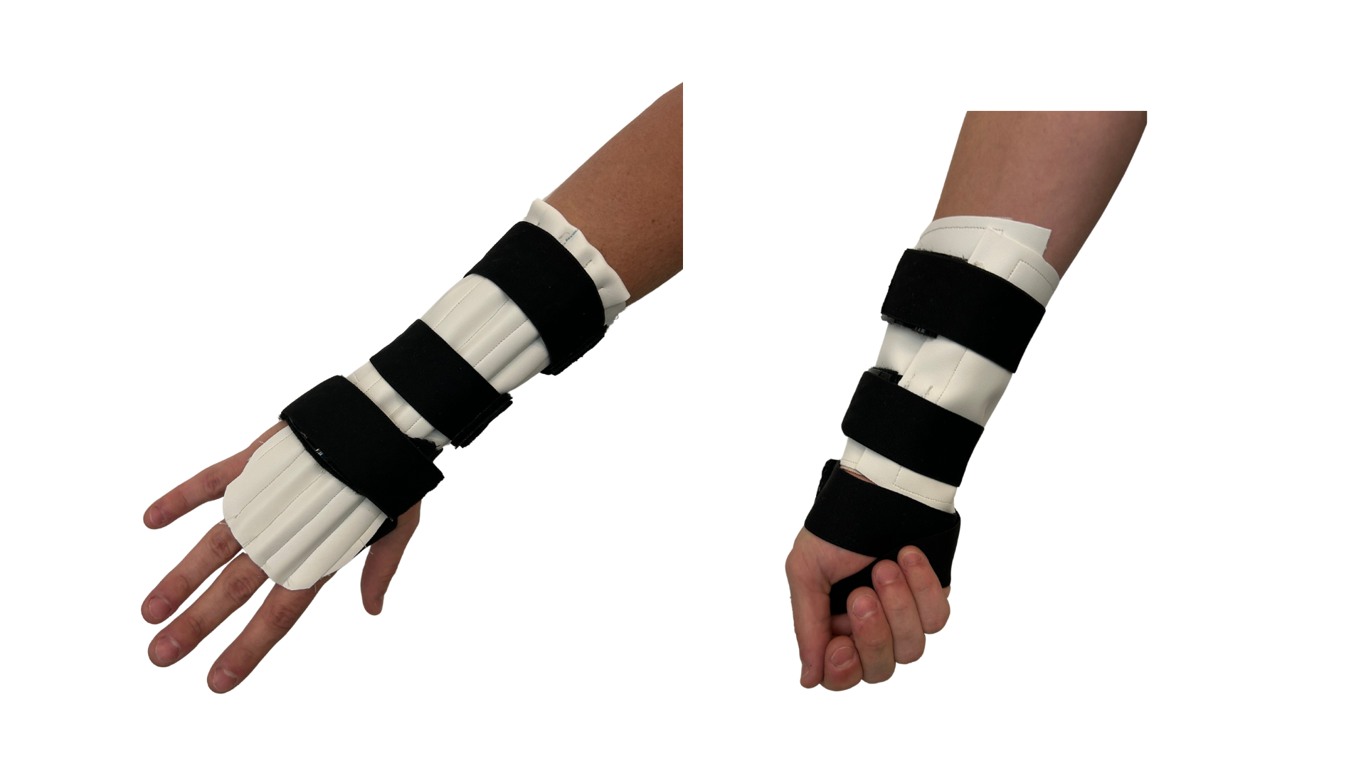
ARTHROGRIP PHYSICAL

Slide 12
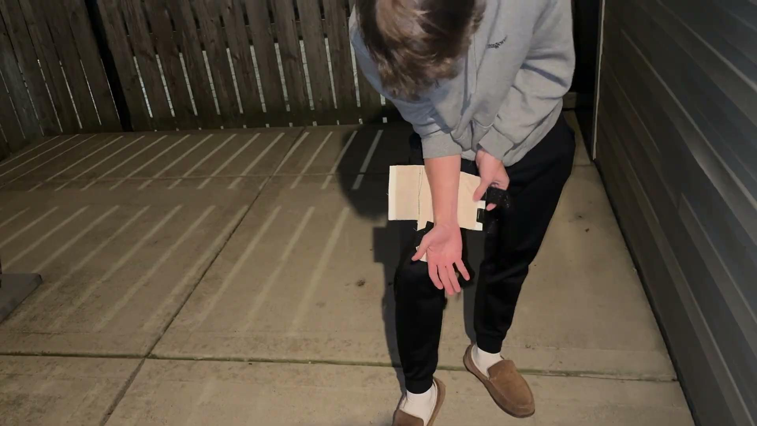
ARTHROGRIP DEMONSTRATION

Slide 13
CONCLUSION
Summary of Key Points
PROBLEM
Golfers risk arthritis due to overworked joints.
SOLUTION
The ArthroGrip Glove offers rigid support with comfort and adjustability.
IMPACT
Supports joint health, broadens reach, and enhances golfer inclusivity.
Notes:
To conclude, our adaptive glove is designed to address the challenges faced by one-armed golfers by preventing injuries, enhancing grip and support, and promoting confidence. Through innovative design and a focus on inclusivity, we aim to make adaptive sports more accessible and enjoyable for all.

Slide 14

THANK YOU!

